Slide 1
COALA IP Protocol Specification

Slide 2
Agenda I
Introduction
Goals
Ideas
The LCC Framework
Technical details
What is IPLD?
What is Linked Data? + useful RDF schemata
What is the Interledger Protocol?

Slide 3
Agenda II
The COALA IP Protocol
Transformations from LCC RRM
Evaluations and Challenges
Roadmap

Slide 4
Introduction

Slide 5
Goals
A licensing framework for digital assets that:
Is easily approachable by all participants (devs, rights holders, copyright societies, …)
Is easily extensible and future-proof
Guarantees immutability and tamper-resistance
Is blockchain-agnostic
Is free (free as in FoS/FOSS) for everyone to participate and use

Slide 6
Ideas
Let’s use:
Linked Data, it’s easily extensible
IPLD, it’s integrity is cryptographically verifiable
ILP, it allows COALA IP to live on many ledgers
The LCC framework, it’s concise and applicable

Slide 7
History
COALA - spinout from MIT & Harvard for blockchain workshops. Meet 3-4 times per year.
IP working group started in fall 2015. Meet at each COALA workshop. Communication in between.
Contributors from COALA, IPFS, Ujo / Consensys, Mycelia, ascribe / BigchainDB, more. Relations to mediachain, SoundCloud, Open Music Initiative, W3C, more.

Slide 8
The LCC Framework

Slide 9
The LCC Framework
Catalogue of documents (main ones used):
LCC Entity Model (short: LCC EM)
LCC Rights Reference Model (short: LCC RRM)
LCC Ten Targets for a Rights Network
LCC Principles of Identification
⇒ style of writing: “implementation-agnostic”
Notes:
The four documents described were mostly used in the specification
Mainly the LCC RRM was considered, as it features proper data models for digital licensing
The LCC EM was discarded as it was just a base/meta model. As a replacement RDF was used (fairly similar)
As the conclusion says: they were all written in an implementation-agnostic style (meaning they are unopinionated about technologies)

Slide 10
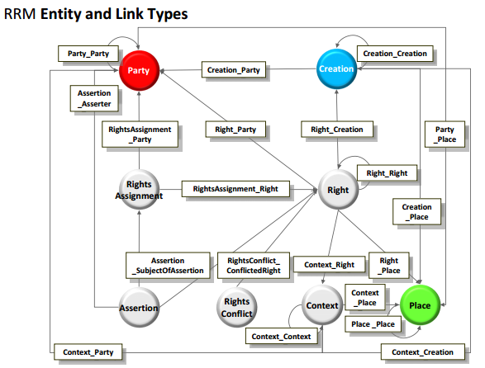
The LCC Rights Reference Model
Represent IP rights digitally
Data model on top of the LCC EM
⇒ 7 (main) entities
Notes:
Picture shows it clearly: Everything is connected to everything
LCC RRM is a theoretical model, so everything was composed to link to everything
In an actual implementation with JSON-LD and IPLD, this will not pose a problem. Why? Because RDF
Context is ignored as an entity, as in the LCC RRM it’s just an abstract class that allows all kinds of types to be linked
⇒ Hence: 7 main entities

Slide 11
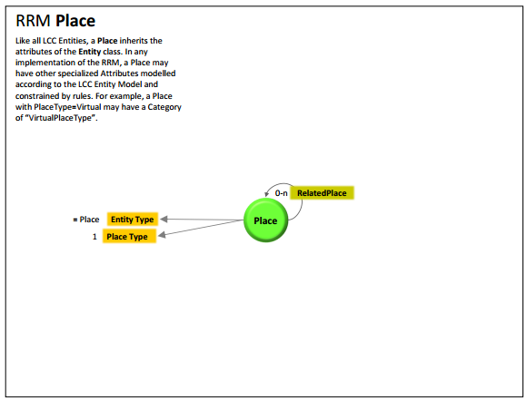
LCC RRM: Place
A localizable or virtual place
For example:
“New York City”; or
“https://newyork.city”
Notes:
It is actually a problem that the LCC RRM defines a Place both virtual and localizable
In the COALA IP spec we draw a clear distinction:
Localizable: Is a physical place
Virtual: Is a URI or an IPLD hash

Slide 12
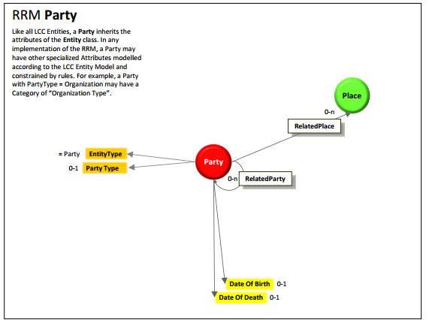
LCC RRM: Party
An individual or a group of individuals (organization)
Represents: right holders, licensors, users
For example:
“Andy Warhol”; or
“Warner Bros. Entertainment”

Slide 13
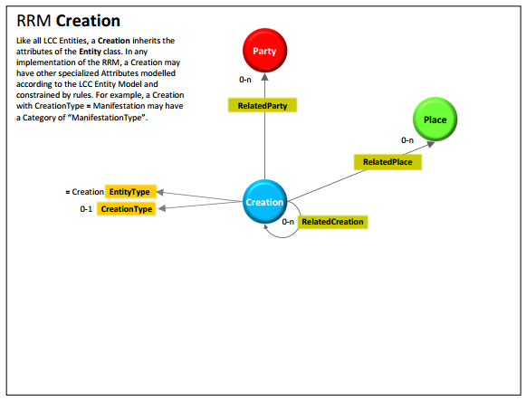
LCC RRM: Creation
Smth (in)directly made by human beings
Separation:
Work and;
Manifestation
For example:
“32 Campbell’s Soup Cans” (by Andy Warhol)
Notes:
Separation goes as follows:
Work: The idea of a photograph
Manifestation: The actual manifestation of that idea (by for example taking the picture digitally/analog)
In this sense, if Parties were to sell their Works, they need to transform Manifestations into Works

Slide 14
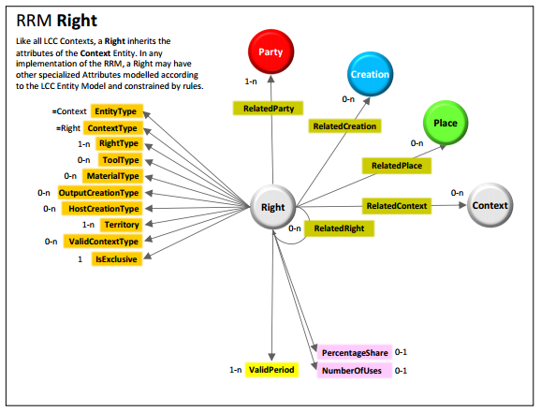
LCC RRM: Right
Set of permissions that entitle a Party to do something with a Creation
For example:
“Andy Warhol controls all Rights to 32 Campbell’s Soup Cans”

Slide 15
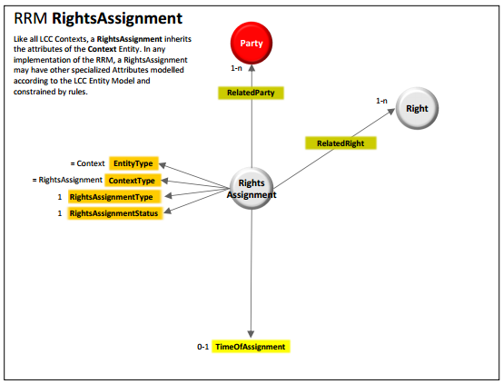
LCC RRM: RightsAssignment
Every possible way to “transfer” a Right from Party to Party
For example:
“I, Andy Warhol declare that ‘32 Campbell’s Soup Cans’ shall be published under CC free use license”
Notes:
In LCC RRM described as it’s own data model, however:
If LCC RRM implemented in immutable ledger, then this can be replaced with transfer and various escrow mechanisms

Slide 16
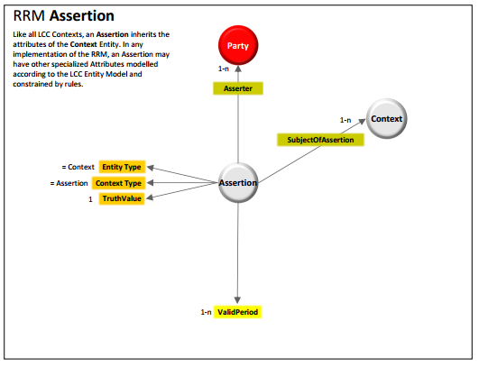
LCC RRM: Assertion
A claim made about the substance of a Right
For example:
“I, the MoMa, New York, claim that Andy Warhol is the righteous creator of ‘32 Campbell’s Soup Cans’”
Notes:
It’s not clear if both RightsConflict and Assertion are needed.
In essence, Assertion is powerful enough to express the functionality of both

Slide 17
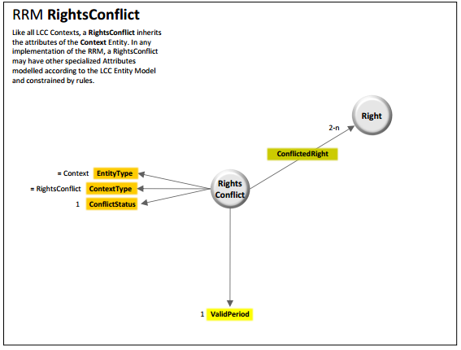
LCC RRM: RightsConflict
A statement of disagreement over a Right
For example:
“I, Tim, declare that Andy Warhol is NOT the righteous creator of ‘32 Campbell’s Soup Cans’”
Notes:
It’s not clear if both RightsConflict and Assertion are needed.
In essence, Assertion is powerful enough to express the functionality of both
⇒ Point to the following:
LCC RRM is a great spec, but its totally unopinionated about tech. So lets just “implement” it
With a tech spec
With a reference implementation

Slide 18
Technical Details

Slide 19
Main technical components
IPLD: Merkle-linking of JSON objects
JSON-LD: URI-linking of JSON objects
Interledger Protocol: Linking of ordered transactions on blockchains
Some canonical identity protocol for the web (specifics: unclear as of now - “Reboot the Web of Trust”?)

Slide 20
What is IPLD?

Slide 21
What is IPLD?
Merkle-linking JSON objects
Cryptographic integrity-checking of data
Merkle-paths JSON objects
Content-addressable data/storage
Notes:
Basically IPLD is two things:
It allows cryptographical integrity-checking of data by merkle-linking json objects
It allows to retrieve data using paths and content-addressed storage

Slide 22
Merkle-Linking example I
import ipld
In [2]: person = {
...: "givenName": "Andy",
...: "familyName": "Warhol",
...: "birthDate": "1928-08-06"
...: }
In [3]: serialized_person = ipld.marshal(person) # serialize using CBOR
Out[3]: b'\xa3ibirthDatej1928-08-06jfamilyNamefWarholigivenNamedAndy'
In [4]: ipld.multihash(serialized_person) # hash CBOR value and get a hash digest
Out[4]: ‘QmRinxtytQFizqBbcRfJ3i1ts617W8AA8xt53DsPGTfisC’
Notes:
We’re importing ipld as a Python package
We’re creating a regular Python dicts
We’re serializing the Python dict using a function of IPLD called ‘marshal’
The result is a binary string representation
Internally, the object is regularily transformed to a CBOR
If a property of type {‘/’: <IPLD hash>} is encountered, then it’s value is tagged with IANA CBOR Tag 258 (Juan Benet wants to register this tag for IPLD)
We’re ‘multihashing’ the object
The object is hashed with an arbitrary hash function (in our case SHA2-256 - don’t panic, it works with whatever fn you prefer)
However, the hash is also prefixed with a hexadecimal value representing the hash function it was hashed with (self-identifying hash function so to speak)
And woops: We have our first IPLD hash

Slide 23
Merkle-Linking example II
In [5]: creation = {
"name":"32 Campbell's Soup Cans",
"dateCreated": "01-01-1962",
"exampleOfWork": "https://en.wikipedia.org/wiki/.../media/File:Campbells_Soup_Cans_MOMA.jpg",
"author": { "/": "QmRinxtytQFizqBbcRfJ3i1ts617W8AA8xt53DsPGTfisC" } # see resulting hash prev slide
}
In [6]: serialized_creation = ipld.multihash(ipld.marshal(creation))
Out[6]: ‘QmfMLNLyJZgvSPkNMvsJspRby2oqP6hWZ8Nd2PvKLhudmK’
Notes:
Using the {‘/’: <IPLD hash>}, we’re creating another object linking to the author object
We’re serializing and (multi-)hashing it as well
What we can do with it, will be explained further in the next section

Slide 24
Merkle-paths example
Resolve path to specific set of information
In [7]: ipld.resolve('/ipfs/QmfMLNLyJZgvSPkNMvsJspRby2oqP6hWZ8Nd2PvKLhudmK/author')
Out[7]:
{“givenNamen”: “Andy”,
“familyName”: “Warhol”,
“birthDate”: “1928-08-06”}
Notes:
We’re asking the IPLD package to resolve a link through IPFS (‘/ipfs/’)
Additionally, we’re addressing the in [5] created object’s ‘author’ property
This is resolved by following the creation[‘/’] hash link to the author
Eventually, ipld yields the author object we’ve previously created
⇒ Imagine instead of writing ‘/ipfs’ we could also write ‘/ipdb’ or other immutable ledgers :)
Disclaimer: I’m not sure if this is how the path will be structured. Juan Benet knows better.

Slide 25
Why IPLD?
Benefits:
Crypto-integrity checking
Content-addressing
Inter-ledger resolvability
Canonicalized ID
Immutability
Future-proof (multihash)
Caveats:
Non-standard protocols (multi-x)
Breakage with established protocols (e.g. URI)
Non-compatible with LD ontology
Notes:
Notes to benefits:
Future proof: Due to multihash, hash function can be upgraded at any point in time
Using the hash + multi hashing info + data everyone can integrety check the data they’ve just received
“Inter-ledger resolvability”: Interplay with all the other technologies out there: Mediachain, IPFS (everyone that’s using IPLD)
Notes to caveats:
“Non-compatible with LD ontology”: Most Linked Data ontologies assume that data is updatable. With IPLD, we lose this feature which is why we’ll have to come up with new, immutable ontologies

Slide 26
What is Linked Data?

Slide 27
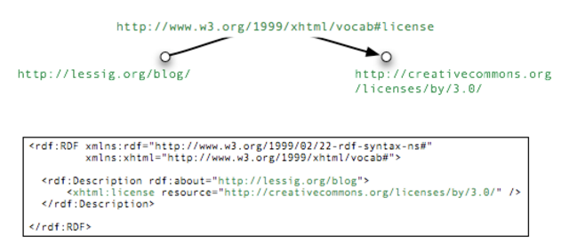
Resource Description Framework (short: RDF)
A way to express assertions in a schematic way
Notes:
Vocabulary: A RDF statement always consists of three parts: Subject - Predicate - Object
All three entities are links (URIs) pointing somewhere
Subject: Lessig’s blog
Predicate: xhtml’s RDF schema definition of a license
Object: The CreativeCommons Attribution license

Slide 28
What is JSON-LD?
Data structure serialize RDF in JSON
{ "@type": "http://schema.org/Person", "@id": "http://example.com/data/AndyWarhol", "givenName": "Andy", "familyName": "Warhol", }
http://example.com/data/AndyWarhol http://www.w3.org/1999/02/22-rdf-syntax-ns#type http://schema.org/Person .
Notes:
In the object you can see that we’re pointing to schema.org’s Person RDF schema
This allows us to validate all properties of the object for types (like ‘givenName’ and ‘familyName’)
It also gives us context: If two applications were to use schema.org’s person definition, they’d know that they’re talking about the same thing: a human beings e.g. ‘familyName’
In the second example you can see the same information described in RDFa
It highlights the special properties of RDF:
Object, Predicate and Subject are all just URIs pointing to documents on the web

Slide 29
Why JSON-LD?
Benefits:
Approachable (compared to XML/RDF)
Extensible
Well-shaped data
Maybe: Cross-usage from Semantic Web
Caveats:
Assumption: Data is mutable
Incompabilities with IPLD
Notes:
Cross-usage from Semantic Web:
When using JSON-LD appropriately, all doors are open to also use other technologies from the semantic web stack
E.g. SPARQL: A semantic web querying language (that can be implemented on server and client side)
Incompabilities with IPLD:
A object cannot reference to itself, as usual for JSON-LD (see: ‘@id’ property)
Most ontologies are built with the assumption that data is mutable
See “popular” ontologies like “Web of Trust” or “Friend of a Friend”

Slide 30
Useful RDF Schemata

Slide 31
Useful RDF schemata I
LCC RRM Party:
schema.org/Person
schema.org/Organization
LCC RRM Creation:
schema.org/CreativeWork
And its subtypes: Book, Movie, MusicComposition
Notes:
For Creation:
We’d create our own RDF schema and derive our Creation type from schema.org’s CreativeWork, which would mean that it could be any of its subtypes: super powerful!

Slide 32
Useful RDF schemata II
LCC RRM Place:
schema.org/Place
LCC RRM Assertion:
schema.org/AssessAction
Additionally: Web of Trust Ontology
Notes:
schema.org/Place can definitely be used
The same might not be true for schema.org/AssessAction
Web of Trust ontology can be found here:
http://xmlns.com/wot/0.1/

Slide 33
What is the Interledger Protocol?

Slide 34

Interledger
The protocol for connecting blockchains
© Interledger Community
Notes:
This talk is about the Interledger protocol. A neutral protocol for financial transactions across different ledgers.

Slide 35
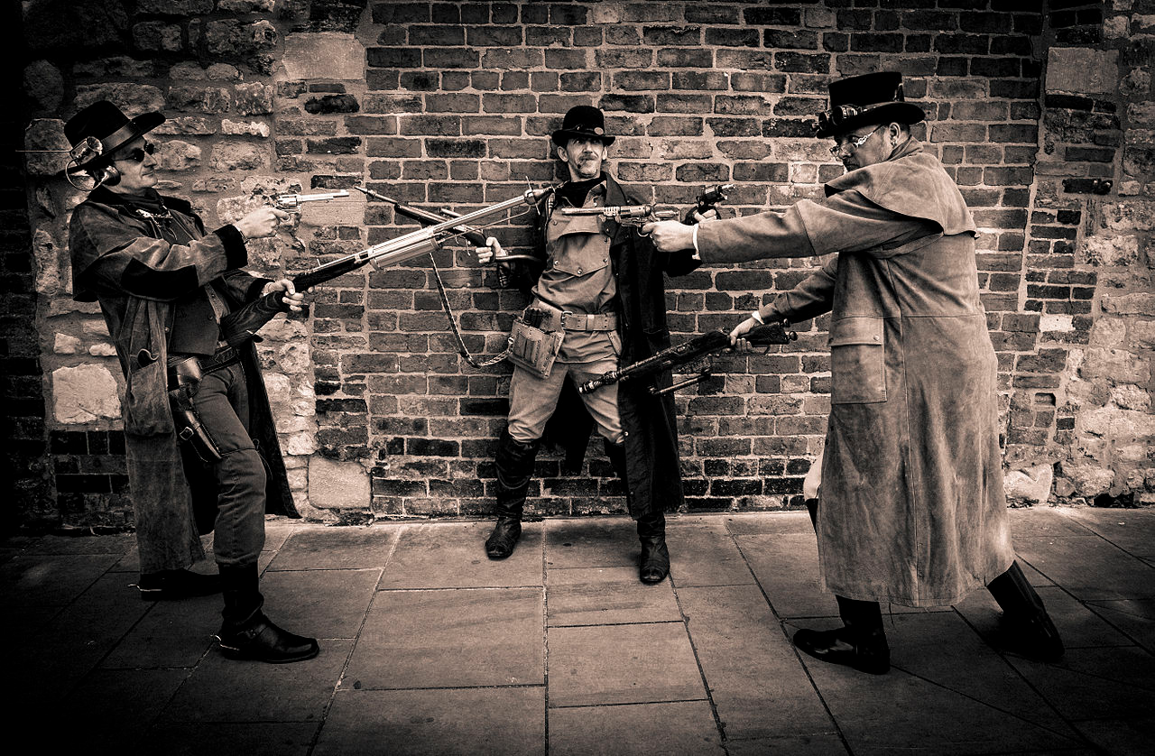
The World Will Never Agree On a Single Ledger
© Interledger Community
Notes:
In other words, people aren't going to agree on exactly one way that all ledgers in the world should work.

Slide 36
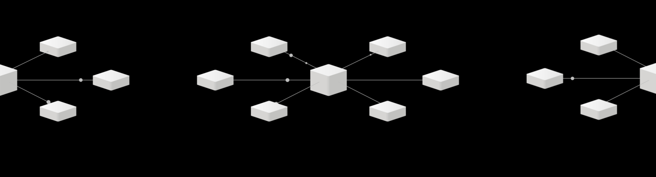
Learning From History
© Interledger Community
Notes:
Networks had a similar problem: They were all separate and if you started your own network, you couldn't talk to anybody.

Slide 37

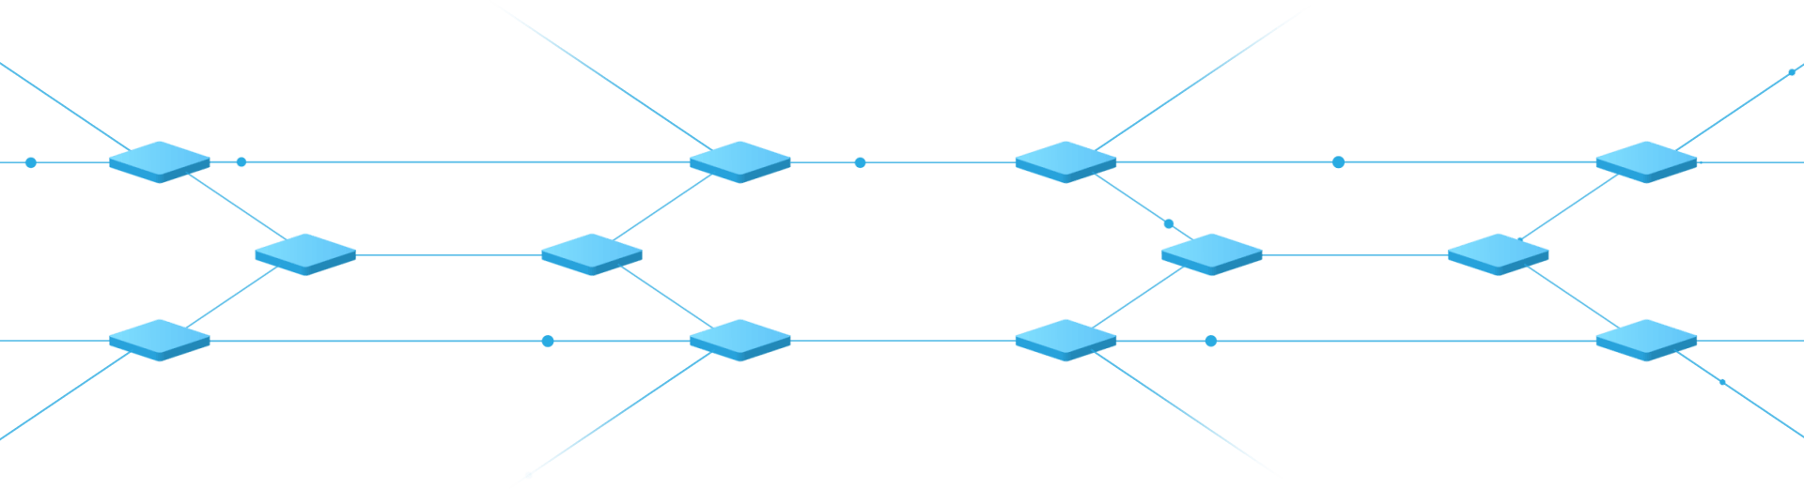
Internet: Network of Networks
© Interledger Community
Notes:
With the Internet, different networks became interoperable and nowadays there are many millions of networks. You probably all have a wifi router, which means you have your very own network at home. And the reason all of these networks can work however they want and still interoperate is the amazing Internet Protocol (IP).

Slide 38
Interledger Architecture
APPLICATION
TRANSPORT
ILP
LEDGER
© Interledger Community
Notes:
And that's all there is to ILP. Of course there are lots of interesting things to say about our transport layer protocols, the ledger plugins and the different application layer protocols for different use cases.

Slide 39



Ledgers track accounts and balances
Sender
Ledger
Recipient
© Interledger Community

Slide 40
But not everyone is on the same ledger
© Interledger Community

Slide 41


Connectors relay assets
Connector
© Interledger Community

Slide 42
Transfers are escrowed L2R, executed R2L
ESCROW
EXECUTION
© Interledger Community

Slide 43


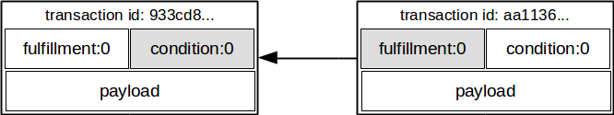
Assets with crypto-conditions
Notes:
This is realized by defining a specific crypto-pair on a ledger’s assets: conditions and fulfillments.. Very much like bitcoin inputs and outputs
Also, there is a payload field that can take any JSON document, ideally for rich asset templating
Every field in the transaction is signed by the owner to make it tamper-resistant

Slide 44
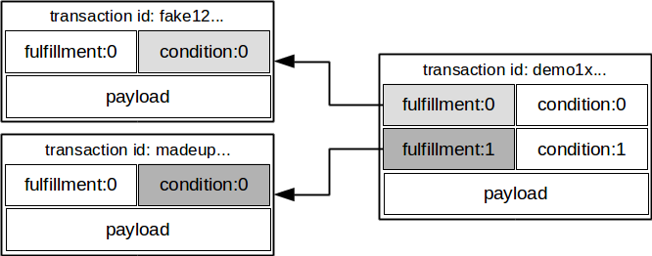
Assets with crypto-conditions
private-public key
multi-signatures
crypto-conditions
smart-contracts
Turing completeness
Notes:
One can group transactions and allow multiple owners.
Ever further, we co-developed the crypto-conditions spec with the interledger community.
Crypto-conditions look a lot like boolean circuits, while smart contracts would be full-featured programs with loops (and recursive flaws)

Slide 45
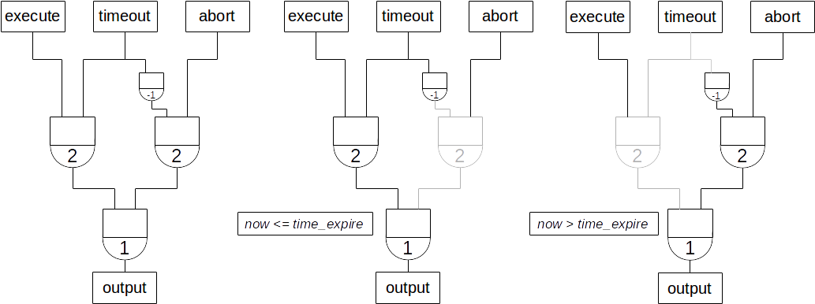
Assets with crypto-conditions
Boolean logic with signatures
Designed by the Interledger community
Notes:
Here is one such example of a cryptocondition. It combines signatures, hashlocks and threshold-signatures (m-of-n) into a logic flow.
This particular example shows how to do escrow in crypto-conditions. Escrow is a conditional release of funds (if-then-else)

Slide 46
COALA IP Protocol

Slide 47
What is the COALA IP Protocol?
A community-driven minimum-viable set of data for Intellectual Property licensing (RDF schema definitions)
A free and open messaging protocol for license-transactions (Interledger & IPLD)
Notes:
COALAIP basically consits of two major standartization efforts:
How do we all agree to a single, minimum-viable set of data that is needed to record licensing on immutable? ⇒ By standardizing a common RDF schema for digital intellectual property licensing
How do we make sure that we can trust someones assertion? ⇒ By putting them on immutable ledgers (IPLD) and by baking in ownership aspects of blockchains (ILP)

Slide 48
COALA IP: Place
{
"@type": { "/": "<hash pointing to RDF-Schema of Place>" },
"geo": {
"@type": { "/": "<hash pointing to RDF-Schema of GeoCoordinates>" },
"latitude": "40.75",
"longitude": "73.98"
},
"name": "Empire State Building"
}
Notes:
Straight forward:
Both ‘@types’ are using IPLD hashes to point to their (immutable RDF schema)
This object itself can be addressed by resolving its hash: Content-addressing

Slide 49
COALA IP: Party (only Individual)
{
"@type": { "/": "<hash pointing to RDF-Schema of Individual>" },
"givenName”: “Andy”,
“familyName”: “Warhol”,
“birthDate”: “1928-08-06”,
“deathDate”: “1987-02-22”
// and any other arbitrary meta data
// TDB: Let’s use an established identity protocol here
}
Notes:
Basically Party can be derived from schema.org’s Person and Organization, so it could have the exact same properties
In the COALA IP spec we call it an Individual, opposed to an Organization

Slide 50
COALA IP: Creation
{
"@type": { "/": "<hash pointing to RDF-Schema of Creation>" },
"name”: “Lord of the Rings”,
“author”: { "/": "<hash pointing to the Author>" }
}
Notes:
Note that a differentiation has been drawn here: For Creation:
There is a Creation RDF schema; and
There is a Manifestation RDF schema (see next slide)

Slide 51
COALA IP: Creation (a digital Manifestation)
{ "@type": { "/": "<hash pointing to RDF-Schema of Manifestation>" },
"name": "The Fellowship of the Ring",
"creation": { "/": "<hash pointing to the Creation>" },
"digital_work": { "/": "<hash pointing to a file on e.g. IPFS>" },
"fingerprints": [
"Qmbs2DxMBraF3U8F7vLAarGmZaSFry3vVY5zytuN3BxwaY",
"<multihash/multifingerprint value>"
],
"locationCreated": "<URI pointing to a Place object>"
}
Notes:
This example shows a digital manifestation of Lord of the Rings (for example an e-book)
Note the following features:
It is linked to a Creation
It is linked to a blob file on IPFS
For the blob file there is a list of fingerprints (numerical values that describe the media file: a md5 hash, a pHash, a image-match vector and so on)
The location it was created

Slide 52
COALA IP: Creation (a physical Manifestation)
{ "@type": { "/": "<hash pointing to RDF-Schema of Manifestation>" },
"name": "The Fellowship of the Ring",
"creation": { "/": "<hash pointing to the Creation>" },
"datePublished": "29-07-1954",
"locationCreated": "<URI pointing to a Place object>"
}
Notes:
This example shows a PHYSICAL manifestation of Lord of the Rings (for example an actual book)
As of now, we do not care for this case: However its nice to have it in the back of our heads

Slide 53
COALA IP: Right
{ "@type": { "/": "<hash pointing to RDF-Schema of Right>" },
“usages”: “all|copy|play|stream|...”,
“territory”: { “/”: “<hash pointing to a Place>” },
“context”: “inflight|inpublic|commercialuse…”,
“exclusive”: true|false,
...
"manifestation": { "/": "<hash pointing to the Manifestation>" },
"license": { "/": "<hash pointing to the License>" }
}
Notes:
Main features:
A Right has a property called ‘manifestation’ pointing a Manifestation of a Creation
Additionally a Right has a set of properties that allow a user to determine the outline of a right
‘usages’ : The type of a Right and how it can be used
‘territory’: Where in the world the Right is applicable
‘context’: A context in which the Right must be exercised
‘exclusive’: A flag indicating whether or not a Right is exclusive to a rights holder

Slide 54
COALA IP: RightsAssignment
A special case: RightsAssignments must be stored in an ordered fashion
Store on an Interledger Protocol compliant ledger
Provenance of assets (chain of events)
True ownership of assets (priv and pub key)
Enhanced transfers (escrowed, multi-sig)
⇒ e.g. BigchainDB (implements IPLD and ILP)
Notes:
A LCC RRM RightsAssignment by specification is nothing more than a “transfer of a right”
It wouldn’t make sense to model a transfer object, when we instead can just literally transfer a Right on a ledger that allows it.
What is a ledger that allows a transfer for the COALA IP Protocol?
⇒ A ledger that implements the Interledger Protocol.
Why?
Because it’s an open and free standard (they’re a W3C working group)
Because it enables provenance tracking of assets (all transactions are linked to each other)
Because it enables true ownership of assets (only priv key owner can transfer)
Because they allow for pretty cool types of transfers (cross-ledger transfers, escrows, multisig, …)

Slide 55
Intermezzo:
RightsAssignment on BigchainDB
Notes:
A ledger that implements the ILP specs already is BigchainDB. Let’s take a look on how COALA could be used on it.

Slide 56
BigchainDB: RightsAssignment example I
Add Right to payload of transaction to create it
# Create a Right and write it to BigchainDB
In [1]: tx_create = b.create_transaction(<node_pub>, <creator_pub>, None, 'CREATE', payload=<Minimum viable data set of a Right>)
In [2]: tx_create_signed = b.write_transaction(b.sign_transaction(tx_create, <creator_priv>))
Notes:
Create a transaction and as a payload add a Right
Then simply sign and write it to BigchainDB

Slide 57
BigchainDB: RightsAssignment example II
In [5]: tx_create_signed
Out[5]: {"id":"aa11365317cb89bfdae2375bae76d6b8232008f8672507080e3766ca06976dcd",
"transaction": {
"conditions": [...],
"data": <Right>,
"fulfillments": [...],
"operation": "CREATE",
"timestamp": "1460981671.262047"
}
}
Notes:
As can be seen, the right is represented within the “data” key of “transaction”
For improved readability, “conditions” and “fulfillments” were hidden, in essence though - they’re the integral part of the transaction as they’re responsible for who can claim ownership of what asset.

Slide 58
BigchainDB: RightsAssignment example III
Transfer the asset representing the Right
# Transfer a Right with BigchainDB
In [3]: tx_transfer = b.create_transaction(<creator_pub, <transferee_pub>, tx_signed[‘id’], 'TRANSFER')
In [4]: tx_transfer_signed = b.write_transaction(b.sign_transaction(tx_transfer, <creator_pub>))
Notes:
Next up, take the digital asset and transfer it to a new user (transferee_pub).
Leave the payload blank. Voila, you’ve just transferred a Right.

Slide 59
BigchainDB: RightsAssignment example IV
In [5]: tx_transfer_signed
Out[5]: {"id":"aa11365317cb89bfdae2375bae76d6b8232008f8672507080e3766ca06976dcd",
"transaction": {
"conditions": [...],
"fulfillments": [...],
"operation": "TRANSFER",
"timestamp": "1460981677.472037"
}
}
Notes:
“data” keyword is no present in this payload since it is already included in the “CREATE” transaction of the digital asset

Slide 60
COALA IP: Assertion I
author
creation
Individual: “Andy Warhol”
Creation: “32 Campbell’s Soup Cans”
Manifestation: “32 Campbell’s Soup Cans” Poster
author
Creation: “The Scream”
manifestation
Right: License Manifestation under License “X”
Notes:
Assume we have the following data stored on an immutable ledger:
It basically says:
Andy Warhol is the author of both “32 Campbell’s Soup Cans” and “The Scream”
Only for “32 Campbell’s Soup Cans”, he has actually created a Manifestation from. He also licensed that Manifestation under a Right

Slide 61
COALA IP: Assertion II
author
creation
Individual: “Andy Warhol”
Creation: “32 Campbell’s Soup Cans”
Manifestation: “32 Campbell’s Soup Cans” Poster
author
Creation: “The Scream”
manifestation
toAssert
Right: License Manifestation under License “X”
Assertion: “Correct!”
author
Organization: “MoMA, NYC”
Notes:
Now, imagine MoMA would checkout this ledger and see this big mistake: Andy Warhol didn’t create “The Scream”, that was Edvard Munch!
In that case, the Assertion object is quite handy, it lets an Organization or Individual vouch for some specific assertions.

Slide 62
COALA IP: Assertion III
author
creation
Individual: “Andy Warhol”
Creation: “32 Campbell’s Soup Cans”
Manifestation: “32 Campbell’s Soup Cans” Poster
author
Creation: “The Scream”
manifestation
toAssert
toAssert
Right: License Manifestation under License “X”
Assertion: “Correct!”
Assertion: “Incorrect!”
author
author
Organization: “MoMA, NYC”
Notes:
Additionally, the same statement can be used to weaken object relation that are potentially wrong.
Obviously Andy Warhol didn’t create “The Scream”, that was Edvard Munch.
Depending on how well a certain Individual or Organization is trusted, the link is enforced of weakened within the system.

Slide 63
COALA IP: Assertion III
author
creation
Individual: “Andy Warhol”
Creation: “32 Campbell’s Soup Cans”
Manifestation: “32 Campbell’s Soup Cans” Poster
author
Creation: “The Scream”
manifestation
toAssert
toAssert
Right: License Manifestation under License “X”
Assertion: “Correct!”
Assertion: “Incorrect!”
author
author
Organization: “MoMA, NYC”
Notes:
Of course, data cannot be altered on an immutable ledger. However, an interpreter that looks at the data could take assertion data to make choices on what data to show to an end user.
In this case it would be a quite easy choice to say that “32 Campbell’s Soup Cans” was created by “Andy Warhol” and “The Scream” wasn’t since the great and well-trusted “Museum of Modern Art of New York City” made assertions on those facts, stating that The Scream’s author is not Andy Warhol.

Slide 64
Evaluation

Slide 65
Challenges
Immutable ledgers and data structure: Backlinks only
Directed Graph: Unreachable nodes?
How can ILP and IPLD’s efforts be combined further?
The missing link: How does identity fit in?
Notes:
Since COALA IP is built on top of immutable ledgers and also uses an immutable data structure (IPLD), only undirectional links backwards in time are possible
Makes it difficult to reason about certain things
Is non complient with current heuristiks for system/data modeling (we’ll have to redefine this at one point)
IPLD is an acyclic directed graph. Meaning that there can be nodes that might be difficult to discover and reason about for machines, if they just see partial snapshots of the complete data set. Fancy engineering can solve this.
Another challenge is ILP and IPLD. They have overlaping functionality (for example their linking). We believe it’s feasible and powerful to combine the efforts!
Identity is currently the biggest question mark. The question is: is there an open and free Identity management protocol COALA IP could use?

Slide 66
Interoperability
With data stores through IPLD, compatibility with:
IPFS
Mediachain
...
With ledgers through IPLD & ILP compatibility with:
BigchainDB
Ripple
Bitcoin? Ethereum?
Notes:
With IPLD, we open the COALA IP protocol up to all players that currently use it. Some really nice interplays could and will exist with:
Mediachain
IPFS
BigchainDB (also here, yes)
Every other ledger that decides to implement IPLD :)
With ILP, we’re opening us up to all transactional ledgers that support it:
BigchainDB
Ripple
+ potentially all Cryptocurrencies that are using it
⇒ Exciting times ahead, just think about it: Trading a license against bitcoins 100% trustless :)

Slide 67
Extensibility
With RDF-based data structure:
Community-curatable minimum viable data
With Interledger Protocol:
Exciting escrow opportunities (Money ←escrow → digital license)
Notes:
By using a RDF-based data structure we’re opening up the process to the define the data structure to everyone :)
With ascribe we saw that many users had specific needs for how their creations should be stored on a blockchain:
Compare a book with a photography: In terms of meta data they’re extermely different!
Using the Interledger protocol we’ll always be able to onboard new ledgers:
Imagine an internet in which you could trade every ledger-based asset with one another. A concert ticket against a a license for using a car for a day. Yep, that is in fact a posibility!

Slide 68
Other achievements
Both human and machine readable (compare to ascribe’s SPOOL protocol)
Hyperlinked media: Exciting times for crawlers
Fairly compliant with parts of the LCC framework
Notes:
SPOOL was machine readable, but for humans quite difficult to understand. Now we simply have JSON and linked entities. The data structure could hence literally explored by just clicking links. Just like the web
In connection to that, COALA IP creates basically a linked data structure that is explorable by crawlers and generic linked data applications

Slide 69
Roadmap & Organization

Slide 70
Roadmap
* - July ‘16: Finish COALA IP spec.
July ‘16 - Sept. ‘16: COALA IP reference implementation
After Sept. ‘16:
Use COALA IP reference impl. in prod. systems
Take COALA IP specs to IETF/W3C/???

Slide 71
Organization
Soon, there will be:
A spec hosted publicly on Github
A Github organization
A mailing list
⇒ Interested? Feedback? Ideas?: Please talk to us!
Notes:
Organizational things have not been taken care of yet, but they’ll be very soon!
For now: send us emails: trent@bigchaindb.com, tim@bigchaindb.com

Slide 72
Thanks for listening!
Questions?

